Slide 1

REPUBLIC OF CAMEROON Peace-Work-Fatherland
REPUBLIQUE DU CAMEROON Paix-Travail- Patrie
PERSONALIZED PROJECT
THEME: DEVELOPMENT OF A PATIENTS’ CONSULTATION AND FOLLOW-UP PLATFORM FOR CAMEROON GOVERNMENT HOSPITALS
Case Study: ODZA District Hospital
Option: Software Engineering
Presented By
KAMENI SEPDEU ANGE CHRIS
Supervised by
Mrs. ONGUENE Vanessa

Slide 2

INTRODUCTION
CONTEXT, PROBLEMATICS, AND SOLUTIONS
METHODOLOGY
DEMONSTRATION
PERSPECTIVES & CONCLUSION

Slide 3



INTRODUCTION

Slide 4

CONTEXT AND PROBLEMATICS

Slide 5

CONTEXT AND PROBLEMATICS
CONTEXT
Cameroon is a home to 28,7 million inhabitant

Slide 6


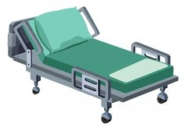
CONTEXT AND PROBLEMATICS
7,8 nurses/10 000
CONTEXT
10 000 hospital beds
1,1 physicians/10 000

Slide 7

CONTEXT AND PROBLEMATICS
HOW CAN WE FACILITATE ENHANCE THE FOLLOW-UP OF PATIENTS THROUGH ONLINE CONSULTATION ?
PROBLEMATIC

Slide 8

SOLUTIONS
iKare is the solution

Slide 9



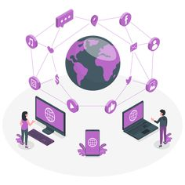

SOLUTIONS
iKare

Slide 10
METHODOLOGY

Slide 11
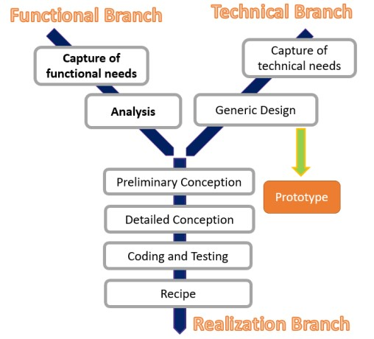

METHODOLOGY

Slide 12
FUNCTIONAL BRANCH
GENERAL USECASE DIAGRAM

Slide 13
FUNCTIONAL BRANCH
Book appointment Activity DIAGRAM

Slide 14
REALIZATION BRANCH
PACKAGE DIAGRAM

Slide 15
CLASS DIAGRAM
REALIZATION BRANCH

Slide 16
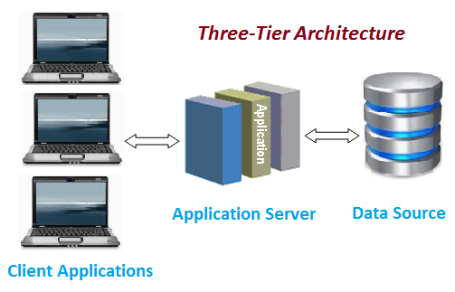
TECHNICAL BRANCH
PHYSICAL ARCHITECTURE

Slide 17
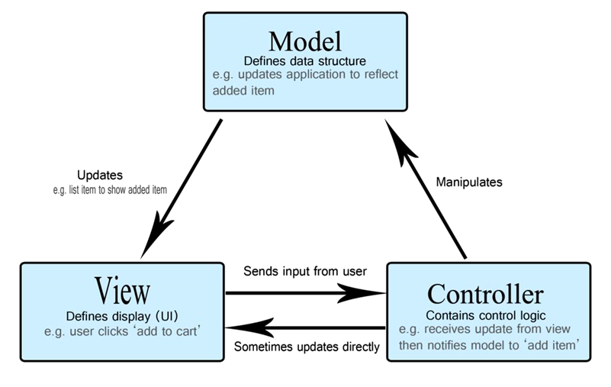
TECHNICAL BRANCH
LOGICAL ARCHITECTURE

Slide 18






TOOLS
DEVELOPMENT TOOLS

Slide 19

DEMONSTRATION

Slide 20


P
E
R
S
P
E
C
T
I
V
E
S
&
C
O
N
C
L
U
S
I
O
N
PERSPECTIVES

Slide 21

THANK YOU

